Slide 2
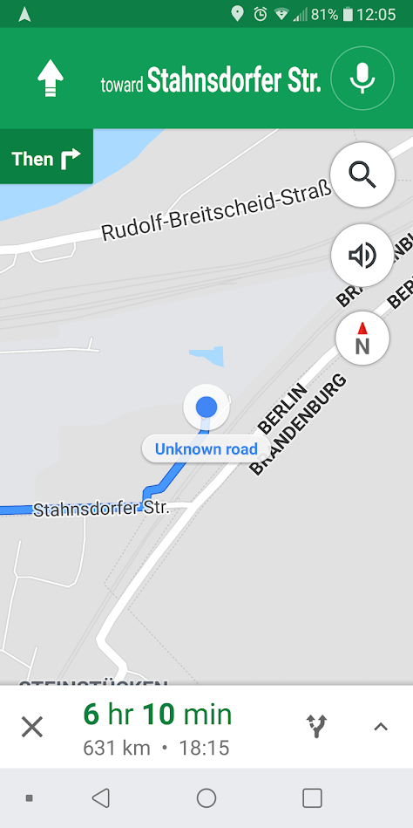
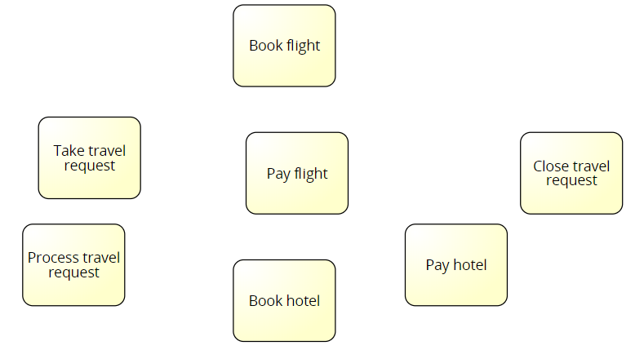
Thinking towards turn-by-turn navigation for case management
How can we predict which activity will be started next?
Notes:
Route details are known ahead of time
Route planning happens mostly without respecting environmental factors
Rerouting has to be done manually
Consequences of detours are mostly unknown
The more often the route is driven, the less the plan is questioned
Target defines direction
Turn-by-turn navigation
Integration of current traffic information into planning
Ad-hoc rerouting based on current traffic information with consequence planning

Slide 3
Deep Learning Next-Activity Prediction With Cluster-Based Input Data
Thesis Topic Presentation
Felix Wolff

Slide 4
Deep Learning Next-Activity Prediction With Cluster-Based Input Data

Slide 5
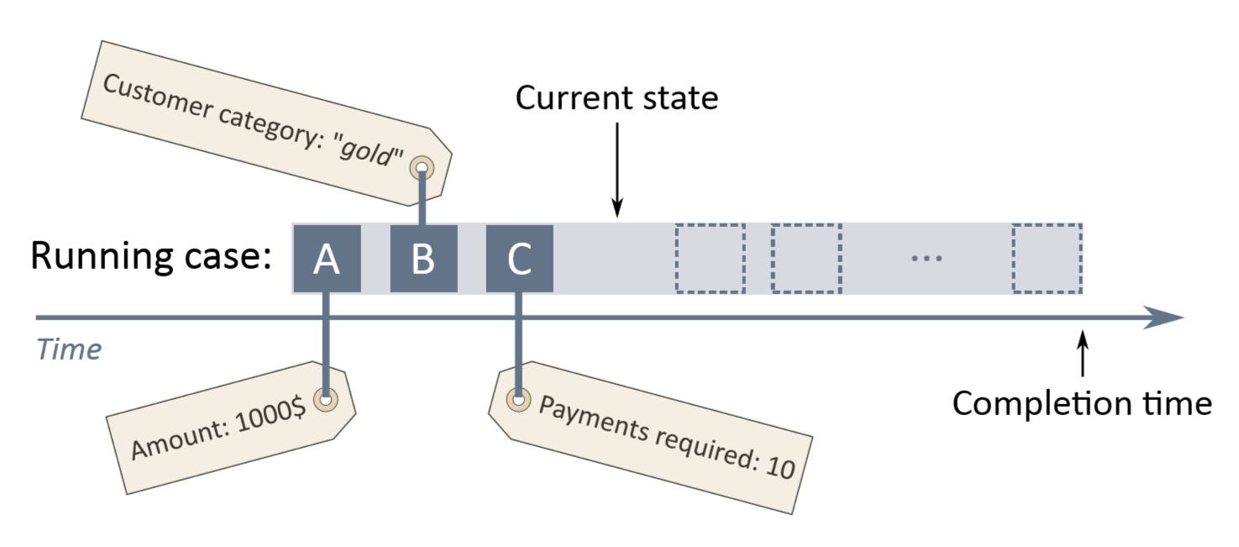
What comes next?
Deep Learning
Next-Activity Prediction
With Cluster-Based Input Data
Well researched: Remaining time prediction Case outcome prediction Predicate compliance prediction
Source:
Polato, M., Sperduti, A., Burattin, A. and de Leoni, M., 2014, July. Data-aware remaining time prediction of business process instances. In Neural Networks (IJCNN), 2014 International Joint Conference on (pp. 816-823). IEEE.

Slide 6
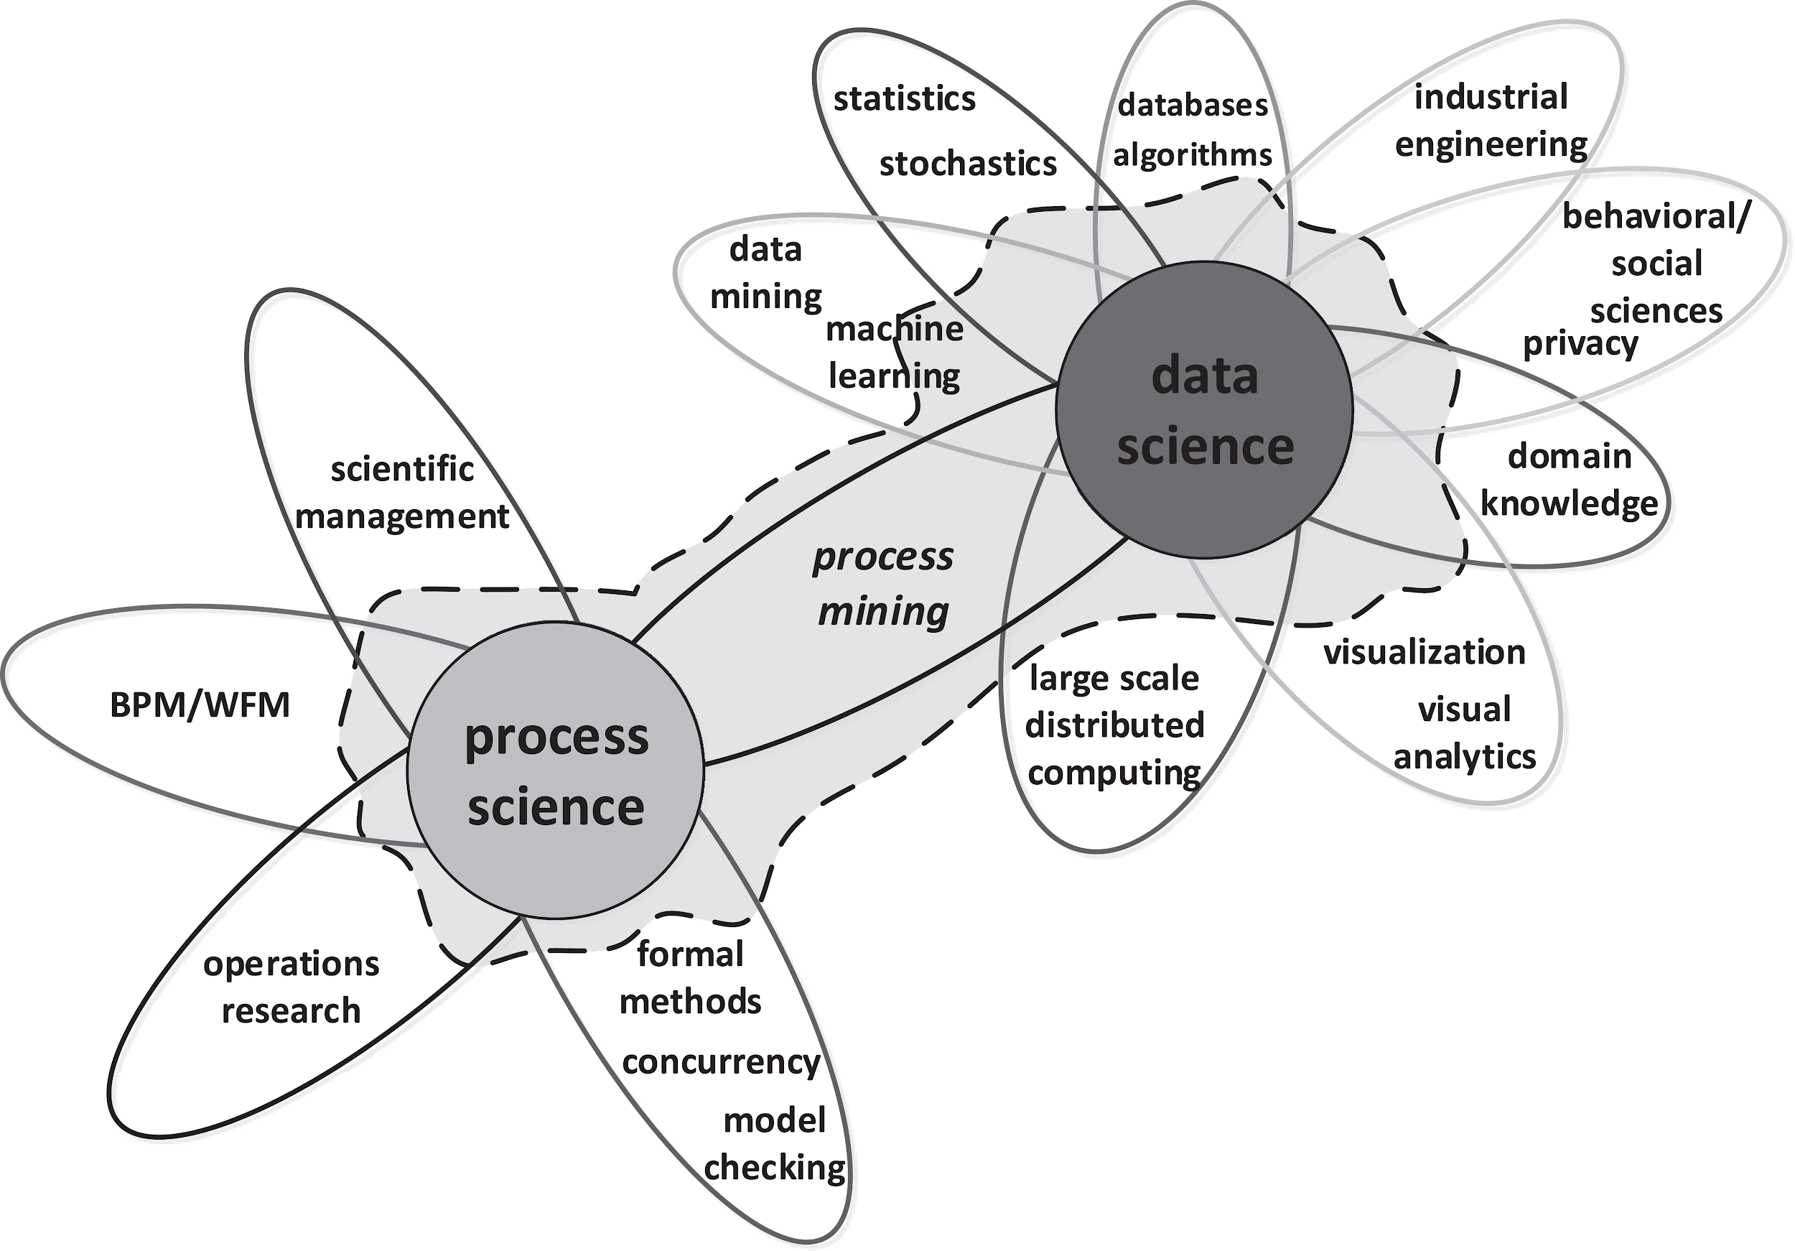
Predictive Process Monitoring
Deep Learning
Next-Activity Prediction
With Cluster-Based Input Data
Source:
van der Aalst, W. M. P. (2016), Process Mining: Data Science in Action , Springer , Heidelberg .
Presentation by Marlon Dumas: https://www.slideshare.net/MarlonDumas/process-mining-and-predictive-process-monitoring
Notes:
Workflow Management Systems provide an infrastructure for the set-up, performance and monitoring of a defined sequence of tasks. The progress of a case inside the system is recorded in the form of logs.
Predictive analytics encompasses a variety of statistical techniques from data mining, predictive modelling, and machine learning, that analyze current and historical facts to make predictions about future or otherwise unknown events.
Workflow Management
+ Predictive Analytics
-----------------------------
Predictive Process Monitoring

Slide 7
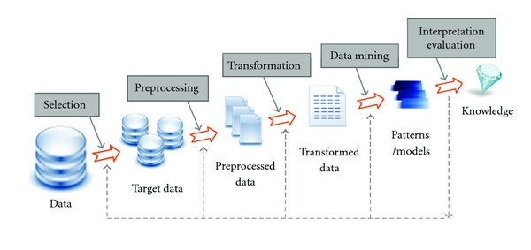
Developing a predictive model
Deep Learning
Next-Activity Prediction
With Cluster-Based Input Data
Knowledge Discovery in Databases (KDD) process
is also suitable for predictive model development
Source:
Fayyad, U., Piatetsky-Shapiro, G. and Smyth, P., 1996. From data mining to knowledge discovery in databases. AI magazine, 17(3), p.37.
Notes:
Alternative process CRISP-DM (industry standard) is less illustrative and very similar.

Slide 8
Data: An example
Deep Learning
Next-Activity Prediction
With Cluster-Based Input Data
1,"2012-09-04","2012-09-06",1507,"?","green",102,24.9,46943,"Mrs","1964-11-14","Rhineland-Palatinate","2011-02-16",1 2,"2012-11-03","2012-11-07",1745,"10","blue",64,75,60979,"Mrs","1973-08-29","Brandenburg","2011-05-21",0 3,"2013-01-29","2013-01-31",2588,"XXL","red",42,79.9,72232,"Mrs","1949-08-23","Saarland","2013-01-28",1 4,"2012-08-08","2012-08-13",164,"40","black",47,79.9,41242,"Mrs","1960-12-26","Thuringia","2012-08-08",1 5,"2012-09-16","2012-10-15",1640,"l","anthracite",97,69.9,8810,"Mrs","1971-06-26","Baden-Wuerttemberg","2012-01-17",1 6,"2013-03-14","2013-03-25",2378,"38","grey",72,129.9,15761,"Mrs","1965-10-01","NRW","2011-02-16",?
Source:
Fayyad, U., Piatetsky-Shapiro, G. and Smyth, P., 1996. From data mining to knowledge discovery in databases. AI magazine, 17(3), p.37. Stefan Lessmann. Business Analytics & Data Science lecture 2017/2018
Notes:
Supervised learning, training and test set
Will walk through this data example step by step
In my case: XEV logs

Slide 9
Feature Selection and Preprocessing
Deep Learning
Next-Activity Prediction
With Cluster-Based Input Data
Which feature should be predicted? Which other features should be used for that?
1,"2012-09-04","2012-09-06",“M","green",102,24.9,46943,"Mrs","1964-11-14","Rhineland-Palatinate","2011-02-16",1 2,"2012-11-03","2012-11-07","10","blue",64,75,60979,"Mrs","1973-08-29","Brandenburg","2011-05-21",0 3,"2013-01-29","2013-01-31","XXL","red",42,79.9,72232,"Mrs","1949-08-23","Saarland","2013-01-28",1 4,"2012-08-08","2012-08-13","40","black",47,79.9,41242,"Mrs","1960-12-26","Thuringia","2012-08-08",1 5,"2012-09-16","2012-10-15",“L","anthracite",97,69.9,8810,"Mrs","1971-06-26","Baden-Wuerttemberg","2012-01-17",1 6,"2013-03-14","2013-03-25","38","grey",72,129.9,15761,"Mrs","1965-10-01",“Nordrhein-Westfalen","2011-02-16",?
Source:
Fayyad, U., Piatetsky-Shapiro, G. and Smyth, P., 1996. From data mining to knowledge discovery in databases. AI magazine, 17(3), p.37.
Stefan Lessmann. Business Analytics & Data Science lecture 2017/2018
Notes:
Data Cleansing (e.g. value imputation, quality assurance)
Correlation analysis (some statistical models are sensitive to this)
Partial Dependence Plots (PDP)
Variable Importance Factors (VIF)

Slide 10
Feature transformation
Deep Learning
Next-Activity Prediction
With Cluster-Based Input Data
Can we assist the model learning by structuring the data differently?
1,"2012-09-04","2012-09-06",“M","green",102,24.9,46943,"Mrs","1964-11-14","Rhineland-Palatinate","2011-02-16", 1, 1 2,"2012-11-03","2012-11-07","10","blue",64,75,60979,"Mrs","1973-08-29","Brandenburg","2011-05-21", 0.75, 0 3,"2013-01-29","2013-01-31","XXL","red",42,79.9,72232,"Mrs","1949-08-23","Saarland","2013-01-28", 0.5, 1 4,"2012-08-08","2012-08-13","40","black",47,79.9,41242,"Mrs","1960-12-26","Thuringia","2012-08-08", 0, 1 5,"2012-09-16","2012-10-15",“L","anthracite",97,69.9,8810,"Mrs","1971-06-26","Baden-Wuerttemberg","2012-01-17",0.1,1 6,"2013-03-14","2013-03-25","38","grey",72,129.9,15761,"Mrs","1965-10-01",“Nordrhein-Westfalen","2011-02-16", 0.2, ?
Source:
Fayyad, U., Piatetsky-Shapiro, G. and Smyth, P., 1996. From data mining to knowledge discovery in databases. AI magazine, 17(3), p.37.
Stefan Lessmann. Business Analytics & Data Science lecture 2017/2018
Notes:
Feature engineering (e.g. average return rate per customer)
Seasonality adjustment
Data clustering

Slide 11
Feature transformation
Deep Learning
Next-Activity Prediction
With Cluster-Based Input Data
Can we assist the model learning by structuring the data differently?
Tasks common in this step:
Feature engineering (e.g. average returns per customer)
Seasonality adjustment
Data clustering
Source:
Fayyad, U., Piatetsky-Shapiro, G. and Smyth, P., 1996. From data mining to knowledge discovery in databases. AI magazine, 17(3), p.37.
Stefan Lessmann. Business Analytics & Data Science lecture 2017/2018

Slide 12
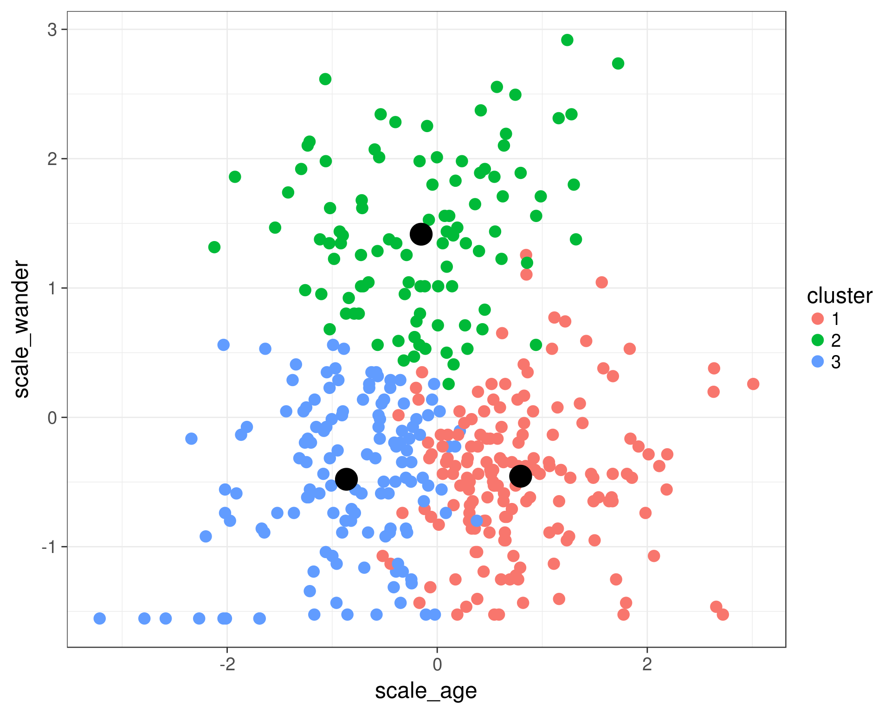
Francescomarino: Clustering
Deep Learning
Next-Activity Prediction
With Cluster-Based Input Data
Predicate fulfilment prediction by exploiting past execution traces, including control flow and data attributes.
Model training:
Cluster learning data via k-means or DBSCAN
Train one model per cluster with data only from that cluster
Predicting:
Assign data item to a cluster
Pick the model that was trained on this cluster and use it for prediction
Source:
Di Francescomarino, C., Dumas, M., Maggi, F.M. and Teinemaa, I., 2016. Clustering-based predictive process monitoring. IEEE Transactions on Services Computing
Clustering graphic: https://rpubs.com/cyobero/k-means.

Slide 13
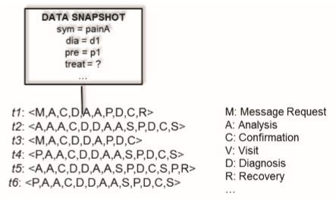
Francescomarino: Encoding
Deep Learning
Next-Activity Prediction
With Cluster-Based Input Data
Francescomarino also hints at another topic which very few of the works related to next-activity prediction have mentioned or elaborated on:
Data preparation and encoding
Frequency-based encoding of a trace
(3,2,2,1,1,1,0,0,0)
Fixed-width history encoding
Schönig et al. only encode the last three events, if any
Variable trace length vs. fixed-length input
1,"2012-09-04","2012-09-06",“M","green",102,24.9,46943,"Mrs","1964-11-14","Rhineland-Palatinate","2011-02-16",1
Source:
Di Francescomarino, C., Dumas, M., Maggi, F.M. and Teinemaa, I., 2016. Clustering-based predictive process monitoring. IEEE Transactions on Services Computing
Schönig, S., Jasinski, R., Ackermann, L. and Jablonski, S., 2018. Deep Learning Process Prediction with Discrete and Continuous Data Features. In ENASE (pp. 314-319).
Clustering graphic: https://rpubs.com/cyobero/k-means.

Slide 14
Model training
Deep Learning
Next-Activity Prediction
With Cluster-Based Input Data
Which machine learning model delivers the best performance on our data?
Common models:
Regression
Decision Tree
Random Forest
Artificial Neural Network
Scalable Vector Machine
Source:
Fayyad, U., Piatetsky-Shapiro, G. and Smyth, P., 1996. From data mining to knowledge discovery in databases. AI magazine, 17(3), p.37.
Stefan Lessmann. Business Analytics & Data Science lecture 2017/2018
Notes:
Model complexity and performance are sometimes on different sides of a spectrum

Slide 15
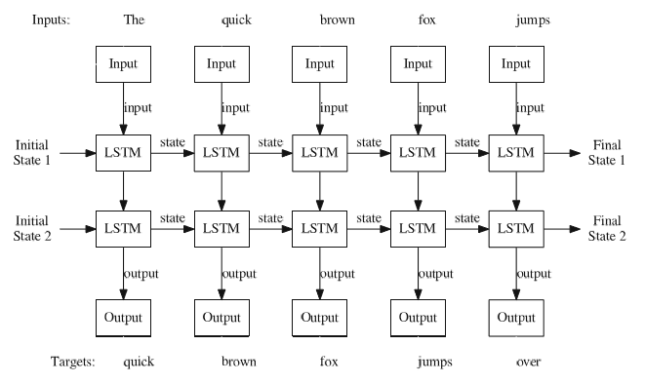
Evermann: LSTM networks
Deep Learning
Next-Activity Prediction
With Cluster-Based Input Data
Next-event prediction using recurrent neural networks with LSTM cells, demonstrating the power of applicability in this context.
Wants to be understood as proof of concept, included long list of future work:
Incorporate case data attributes, they were not used (used by Schönig et al.)
Use more LSTM cells, mean trace length was not respected
Include cross validation
Did not place emphasis on data preparation
Source:
Evermann, J., Rehse, J.R. and Fettke, P., 2016, September. A deep learning approach for predicting process behaviour at runtime. In International Conference on Business Process Management (pp. 327-338). Springer, Cham.
Schönig, S., Jasinski, R., Ackermann, L. and Jablonski, S., 2018. Deep Learning Process Prediction with Discrete and Continuous Data Features. In ENASE (pp. 314-319).

Slide 16
The master plan
Deep Learning
Next-Activity Prediction
With Cluster-Based Input Data
Determine possibilities for structuring learning data to include history and attributes
Cluster training data via appropriate method
Train one LSTM neural network per cluster
Benchmark performance of the combined approaches against results of Francescomarino, Evermann, Schönig and Tax via BPIC 2011, 2012 and 2017 data
Basis for a navigation system for case management
Source:
Di Francescomarino, C., Dumas, M., Maggi, F.M. and Teinemaa, I., 2016. Clustering-based predictive process monitoring. IEEE Transactions on Services Computing
Evermann, J., Rehse, J.R. and Fettke, P., 2016, September. A deep learning approach for predicting process behaviour at runtime. In International Conference on Business Process Management (pp. 327-338). Springer, Cham.
Schönig, S., Jasinski, R., Ackermann, L. and Jablonski, S., 2018. Deep Learning Process Prediction with Discrete and Continuous Data Features. In ENASE (pp. 314-319).
Tax, N., Verenich, I., La Rosa, M. and Dumas, M., 2017, June. Predictive business process monitoring with LSTMs. In Annual machine learning conference of the Benelux (Benelearn2017), 9-10 June 2017, Eindhoven 2017.
Notes:
How can we predict which activity will be started next?

